Slide 1


CodeRAG: Retrieval-Augmented Conversational Agents for Code-Switched, Low Resource Language
Submitted by:
Submitted to:
Aadarsha Mahato (102217264)
Dr. Jyoti Maggu
Arshnoor (102397004)
Assistant Professor-I
BE Fourth Year, CSE
Computer Science and Engineering Department
Thapar Institute of Engineering and Technology, Patiala

Slide 2
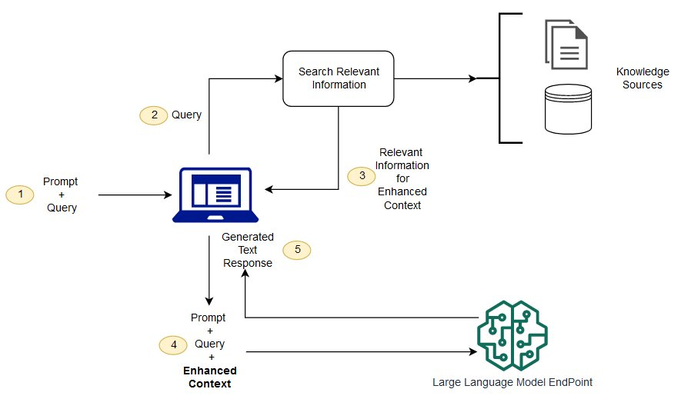

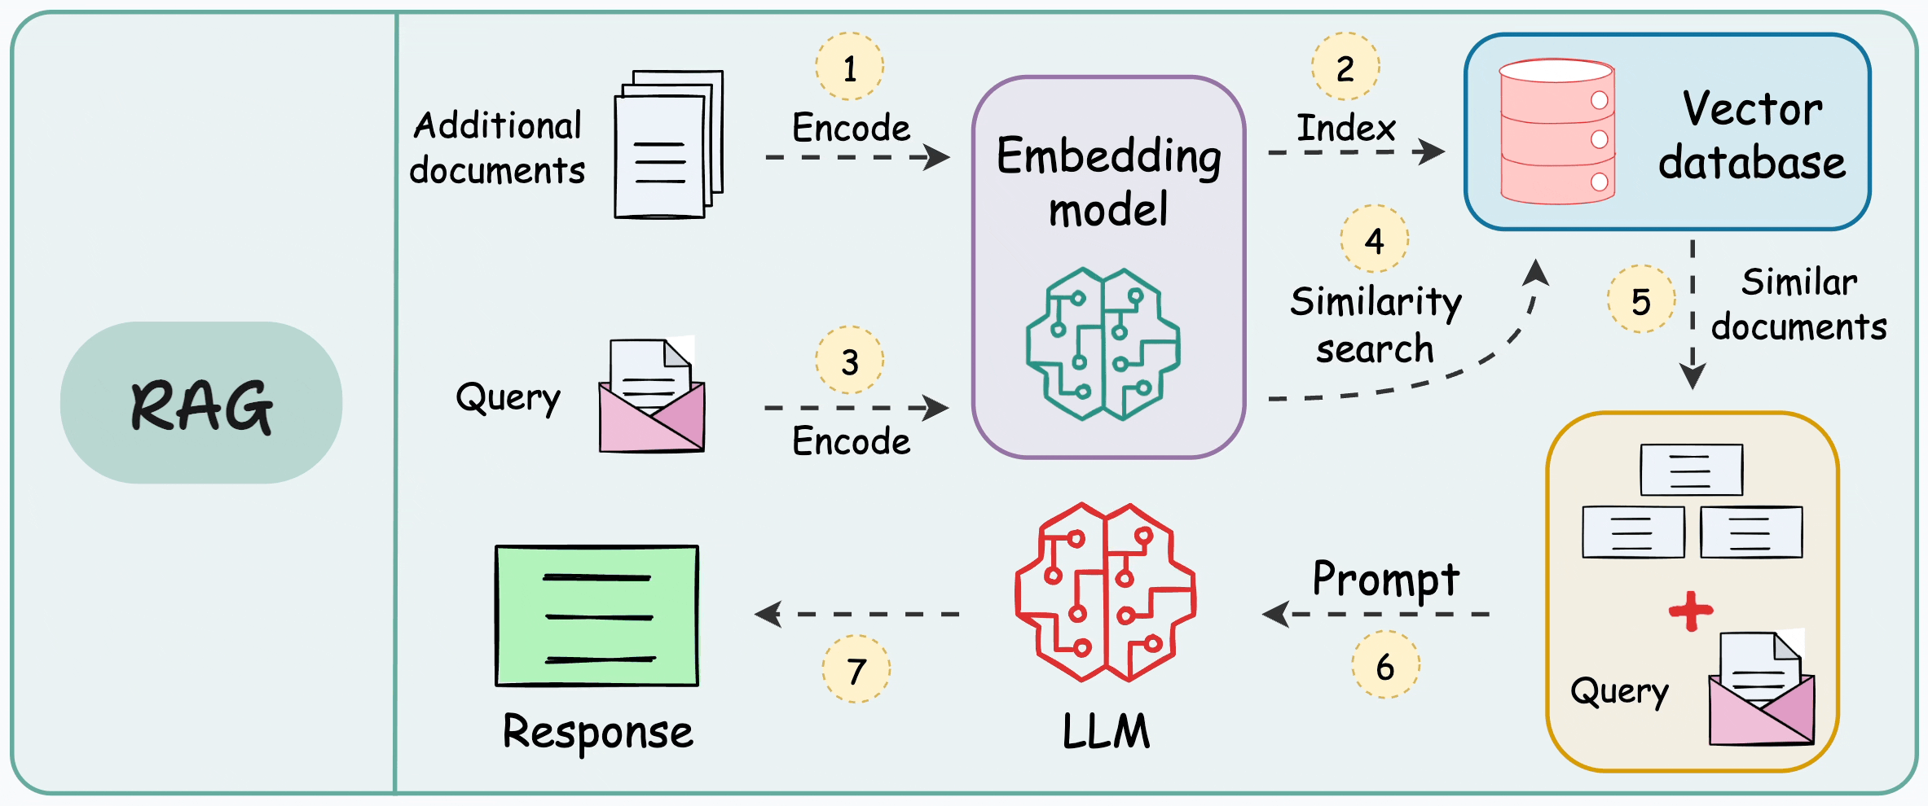
Executive Summary: CodeRAG
CodeRAG is a state-of-the-art Retrieval-Augmented Generation (RAG) system designed for Hinglish (Hindi-English code-switched) question answering.
Hybrid Retrieval
Combines dense (semantic) and sparse (BM25) methods.
Advanced Generation
Gemini-powered answer generation with context-aware prompting.
RL Optimization
REINFORCE algorithm optimizes retrieval weight parameters.
Multi-metric Evaluation
Comprehensive assessment across 6 quality dimensions.

Slide 3
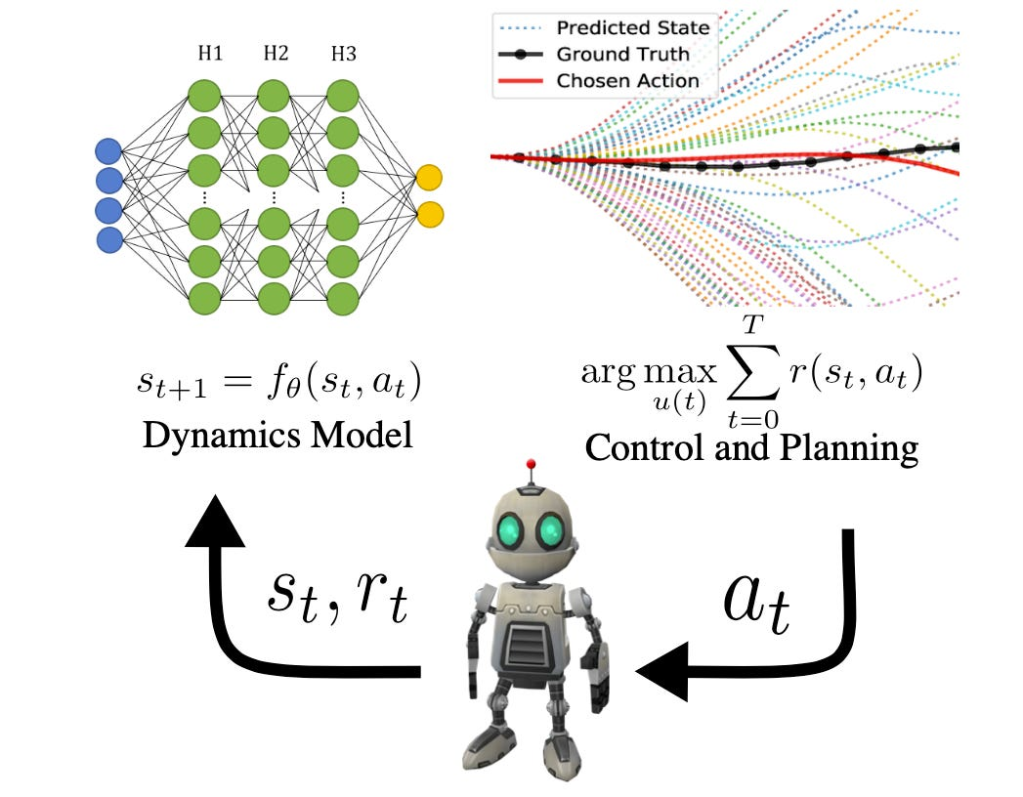
Motivation: The Hinglish Challenge
Hinglish is a dominant communication style, yet most QA systems struggle with mixed-language input.
Mixed-Language Comprehension
Models trained on monolingual data fail to understand Hinglish semantics.
Cultural & Regional Relevance
Lack of cultural grounding and region-specific understanding.
Retrieval Mismatches
Difficulty aligning Hinglish queries with English documents.
Natural Generation
Challenges in producing fluent, natural code-switched outputs.

Slide 4
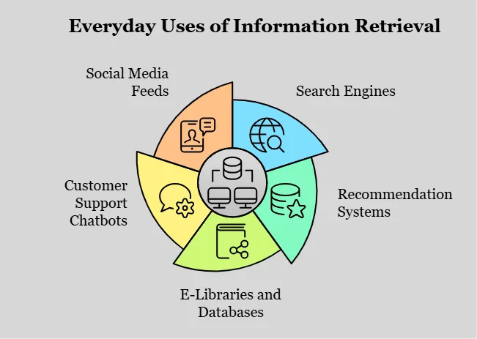
Problem Statement & Objectives
How can we design an effective RAG system for Hinglish queries with high answer quality, contextual grounding, and fluency?
Core Challenges
Primary Goals
Semantic search on mixed-language inputs.
Design hybrid retrieval for Hinglish.
Balancing dense and sparse retrieval for noisy queries.
Apply RL-based optimization for retrieval weights.
Generating fluent, grounded Hinglish responses.
Integrate LLM for context-aware generation.
Reducing hallucinated content.
Achieve superior performance across evaluation dimensions.
Provide intuitive user interface.

Slide 5
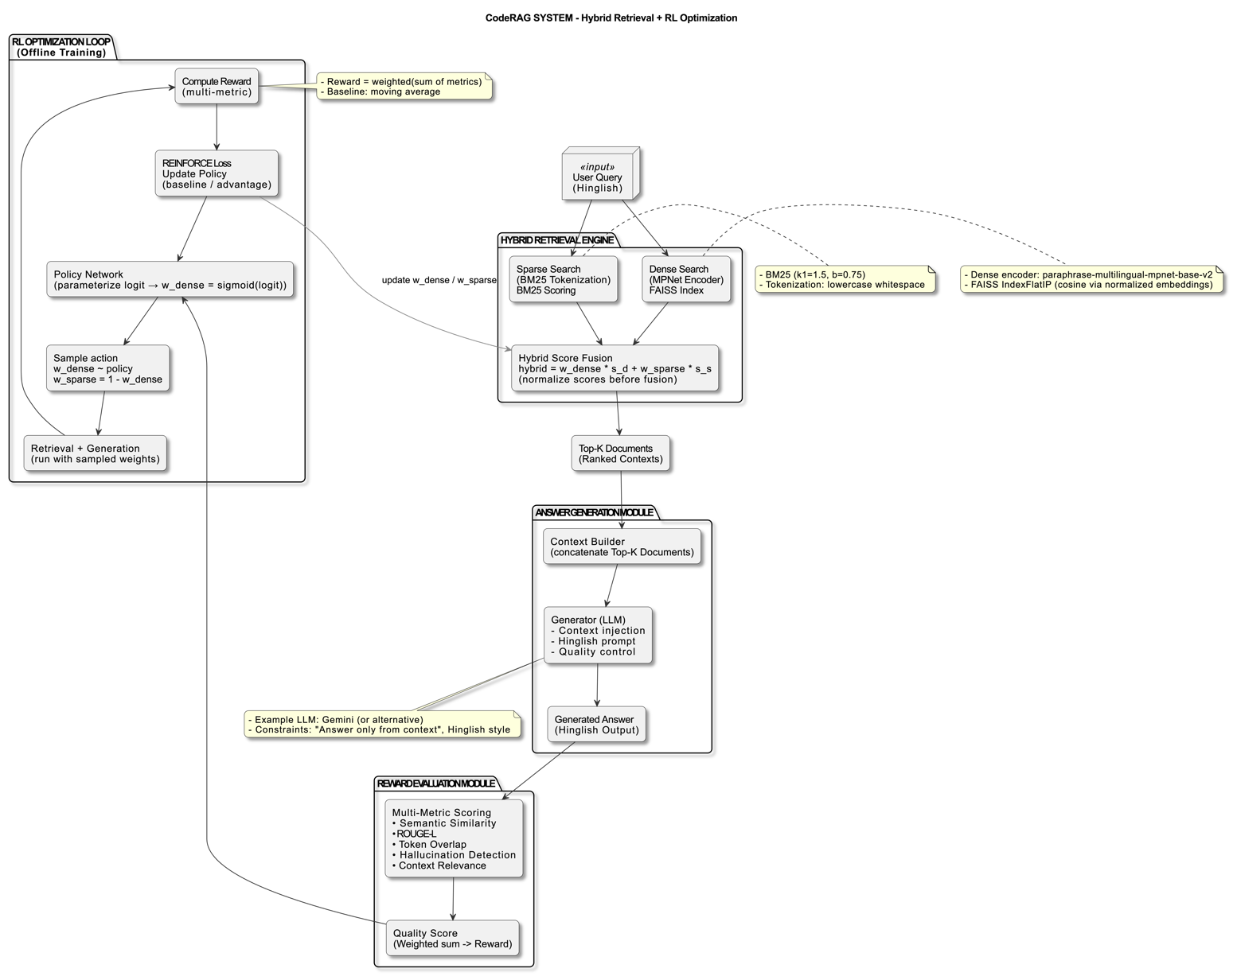
System Architecture Overview
The system integrates a hybrid retrieval engine, a controlled answer-generation module, a reward modeling pipeline, and a lightweight reinforcement learning optimizer. This ensures concise, accurate, and context-grounded Hinglish answers.

Slide 6
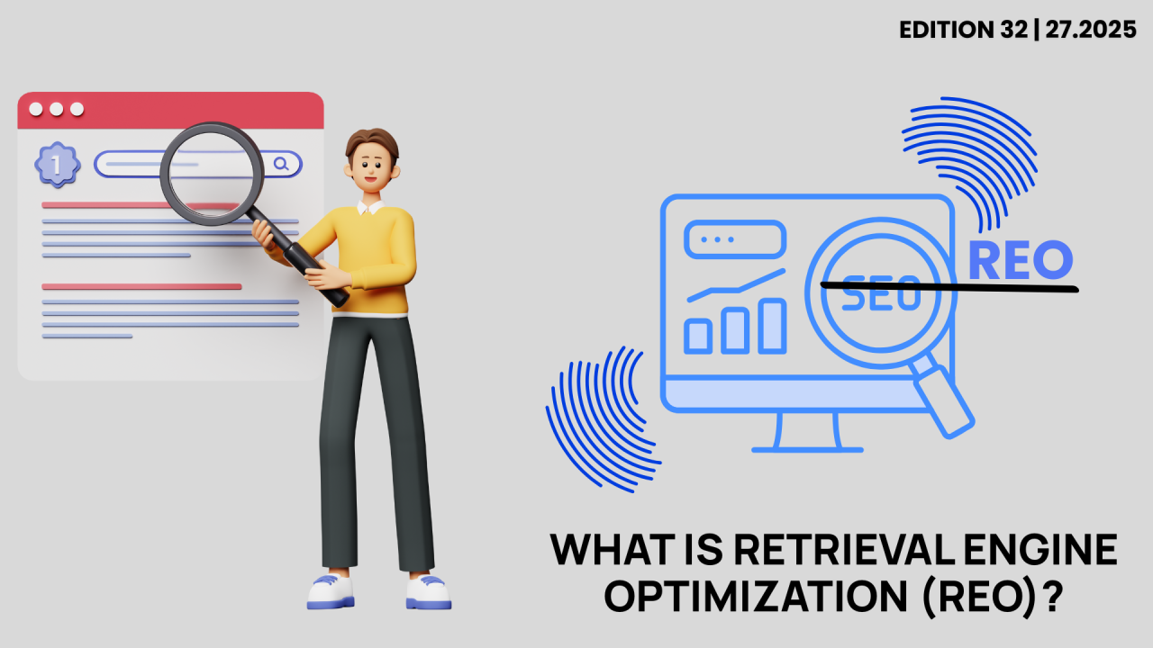
Component Deep Dive: Retrieval & Generation
A. Retrieval Engine
B. Answer Generation
Combines dense (FAISS with paraphrase-multilingual-mpnet-base-v2 embeddings) and sparse (BM25) methods. Hybrid fusion uses RL-learned weights for robust retrieval.
Google Gemini 2.0 Flash generates responses. It receives a structured prompt with retrieved context and user query, producing short Hinglish answers.
Max Output: 200 tokens.
Dense Retrieval: FAISS (IP), L2-normalized vectors.
Temperature: 0.7 (balances creativity and coherence).
Sparse Retrieval: BM25 (k1=1.5, b=0.75).
Constraints: Hinglish tone, concise, context-only, easy to understand.
Hybrid Fusion: w_dense * dense_score + w_sparse * sparse_score.

Slide 7

Component Deep Dive: Reward & Optimization
C. Reward Modeling
D. RL Optimization (REINFORCE)
A fine-tuned DeBERTa-v3-small model evaluates relevance. Augmented with semantic similarity, ROUGE-L, token overlap, hallucination checks, and context quality for a weighted reward signal.
The RL module uses REINFORCE to determine the optimal dense-vs-sparse weight balance (w_dense = sigmoid(logit)). It updates the logit using advantage-weighted gradients to maximize overall response quality.
Evaluation Metrics: Cosine semantic similarity, ROUGE-L F1, Token Jaccard overlap, Hallucination/contradiction detection, Retrieved context quality.
Hyperparameters: Learning rate: 1e-3, Steps: 200, Baseline momentum: α = 0.05.

Slide 8
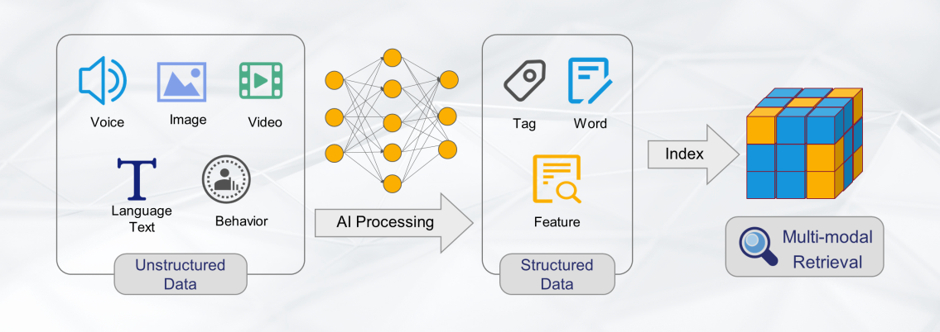

Methodology: Data & Hybrid Retrieval
Data is prepared for Hinglish queries and English answers, then indexed for hybrid retrieval. The system combines dense semantic search and BM25 keyword matching.
Data Preparation
Curated for language consistency, cleaned, deduplicated, and filtered for quality. Dataset splits for training, validation, and testing.
Hybrid Retrieval System
Expands candidate sets, normalizes sparse scores, computes weighted hybrid scores, and returns top-K documents. Ensures fair fusion and reproducible results.

Slide 9

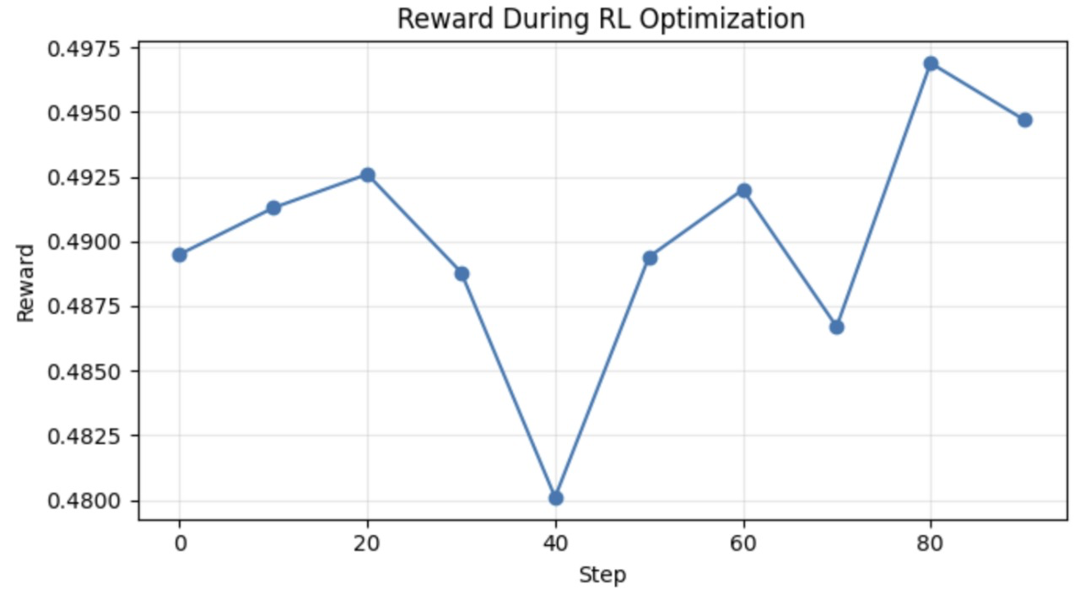
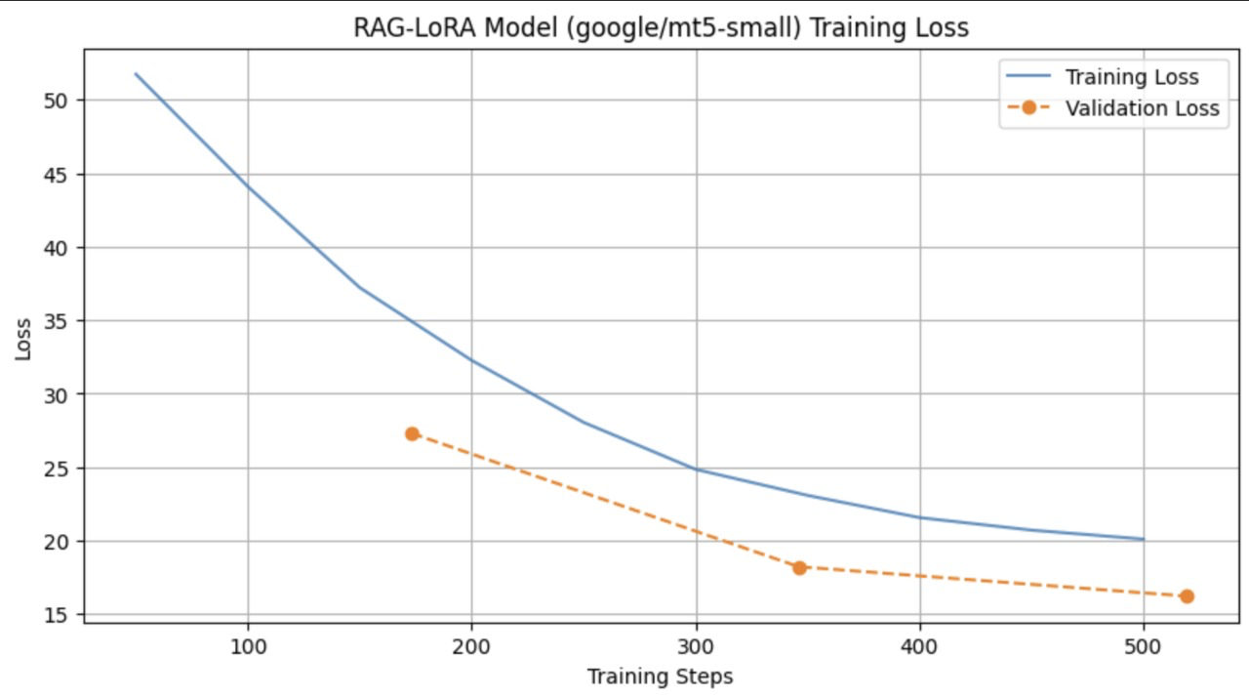
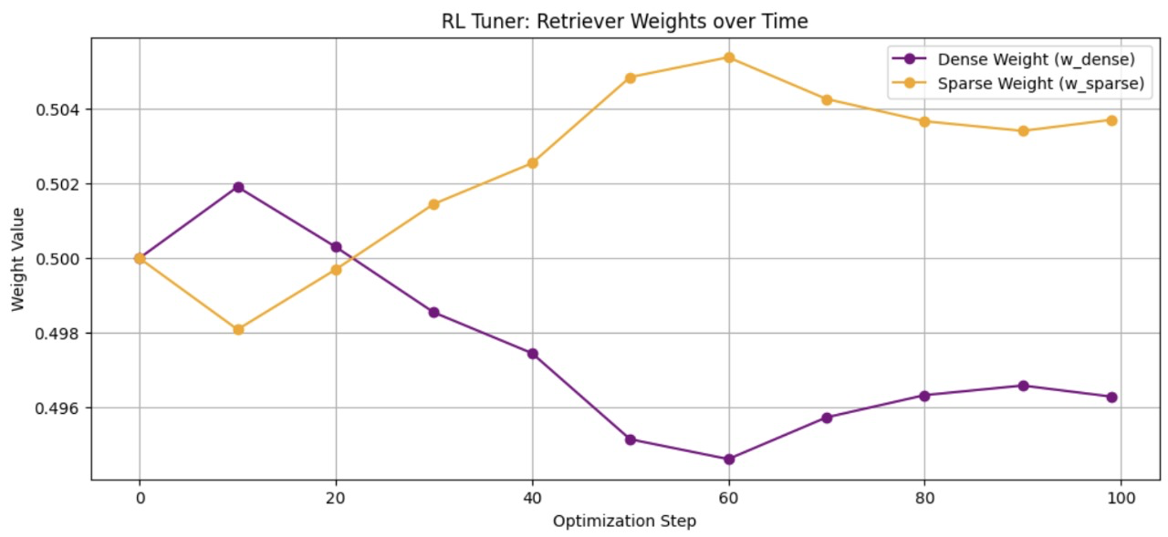
Results and Analysis
The experimental results demonstrate the effectiveness of CodeRAG's hybrid approach and RL optimization.
Key findings include hybrid retrieval outperforming single methods, RL-driven weight optimization improving over static heuristics, and Gemini demonstrating strong Hinglish fluency.

Slide 10
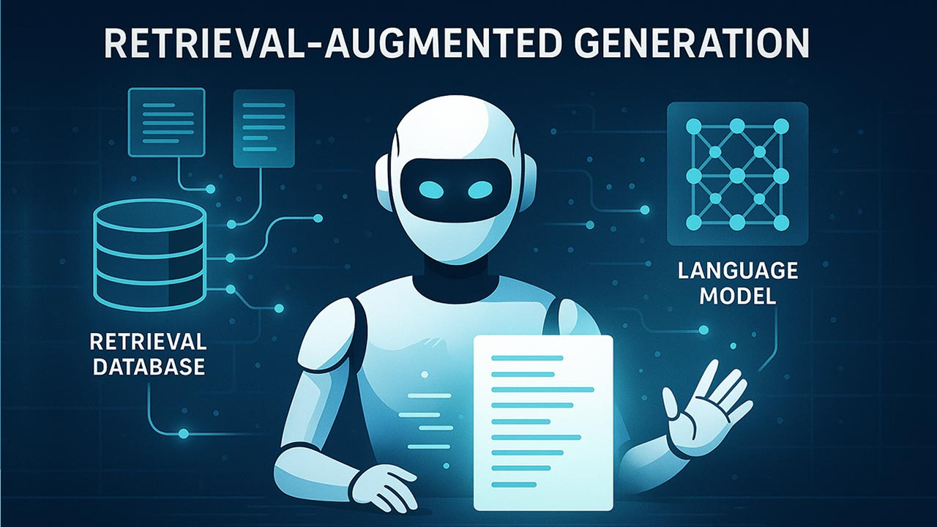
Conclusion & Future Work
CodeRAG significantly improves question answering in code-switched settings like Hinglish through hybrid retrieval and RL optimization.
Current Limitations
Future Directions
Limited language coverage (mostly Hindi-English).
Expand to additional low-resource languages.
Domain specificity issues.
Introduce streaming responses.
Context truncation due to fixed top-k.
Add conversation-history conditioning.
No online learning or user feedback.
Fine-tune reward models on domain-specific datasets.
Limited computational resources.

